Slide 1
Environmental DNA works, now what?
Adam Sepulveda, Katherine O’Donnell, David Smith
U.S. Geological Survey
This information is preliminary and is subject to revision. It is being provided to meet the need for timely best science. The information is provided on the condition that neither the U.S. Geological Survey nor the U.S. Government shall be held liable for any damages resulting from the authorized or unauthorized use of the information.

Slide 2
Outline
Decision-making when you don’t have all the facts
Uncertainty in invasive species detections
Dreissenid mussel case study
Decision model
Next steps with GSARP

Slide 3
Decision-Making When You Don’t Have All the Facts

Slide 4
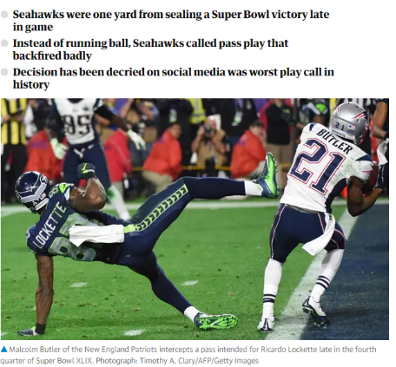
Superbowl: Seahawks vs Patriots
26 sec left
2nd down
1-yard line
Annie Duke
Thinking in Bets: Making Smarter Decisions When you Don’t Have All the Facts

Slide 5
Was it a bad decision?
Probability of interception = 2%
Same decision, different outcome…
Seahawks win Super Bowl, best play ever!
Bad outcome ≠ Bad decision
Bad decision can result in good outcome (dumb luck)
Decision: Drinking & driving
Outcome: Making it home safely

Slide 6
What is a good decision?
Process to make educated guess
Desired outcome
Alternatives
Probabilities of outcome given alternatives
Process increases odds of good outcome when you don’t have all the facts
Poker, not chess!

Slide 7
Uncertainty in environmental (e)DNA & invasions

Slide 8
eDNA sampling
Highly sensitive
Only detects DNA
Outcome uncertainty
eDNA often indicates species presence
But not always
Space-time mismatch
Photo: USGS

Slide 9
Invasion process
Most introductions fail
Outcome uncertainty
Failed introductions
Boom-bust
Sorte 2016

Slide 10
Decision problem
Given uncertainty, what rapid response actions should managers take after early detections?
Focus: eDNA sampling
Generalizable: all methods

Slide 11
Quagga/Zebra mussels & eDNA Jordanelle Reservoir, Utah

Slide 12
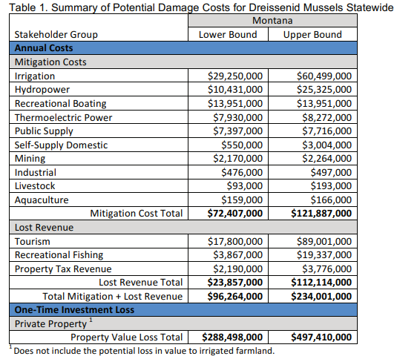
QZ mussels are costly problem
Nelson 2019

Slide 13
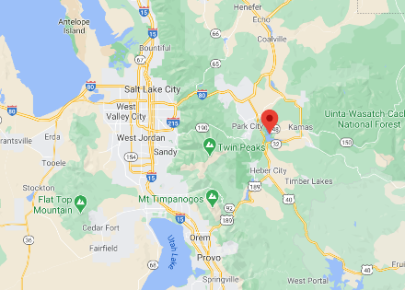
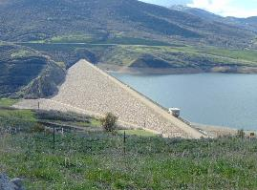
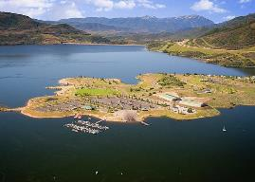
Jordanelle Reservoir (mussel-free)
Dam
Hydropower
Water storage
Water delivery
Utah DWR
Large reservoir
EDRR difficult & costly
Google maps
Recreation & Municipal water
Salt Lake City
Utah DWR
Large potential costs to any action

Slide 14
State agency eDNA monitoring
Utah Dep. Wildlife Resources
Starting eDNA early detection program
Pro-active, not reactive
Identify actions given eDNA detections
Decision process template

Slide 15
Decision model

Slide 16
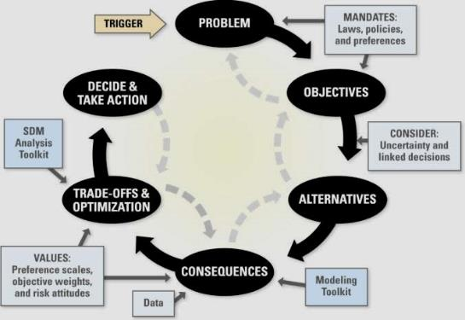
Structured decision making
Decision-maker & stakeholder driven

Slide 17
Problem statement
What are appropriate actions to take following >1 eDNA detections of QZ mussels at Jordanelle?
Immediate (weeks)
Long-term (months to 8 years)
Decision-makers & stakeholders
Utah Division of Wildlife Resources & State Parks
Central Utah Water Conservation District
US Bureau of Reclamation

Slide 18
Objectives
Desired outcomes of decision
Minimize number of closures
(ramp-days)
Minimize spatial extent (% area infested)
Minimize likelihood of regional spread
Maximize level of support (constructed scale)
Minimize costs ($$)
"Preliminary Information-Subject to Revision. Not for Citation or Distribution."

Slide 19
Alternatives
Contain: watercraft inspection stations
Contain + Control: molluscicide
Infestation?
Nothing
Rapid response
Contain
Infestation?
non-eDNA confirmation?
No
Contain + Control
No
Infestation?
Yes
Rapid response | ≥1 eDNA detects
Infestation?
Contain
Nothing
Infestation?
Rapid response
Contain
Infestation?
Contain + Control
Contain + Control
Infestation?
Infestation?
"Preliminary Information-Subject to Revision. Not for Citation or Distribution."
Notes:
Our model is a bit more complex, but the same principles apply. Each branch leads to an outcome, for which we can calculate a UTILITY. We can then work backwards (right to left) to calculate the EV for each decision branch (i.e., those stemming from a square node)

Slide 20
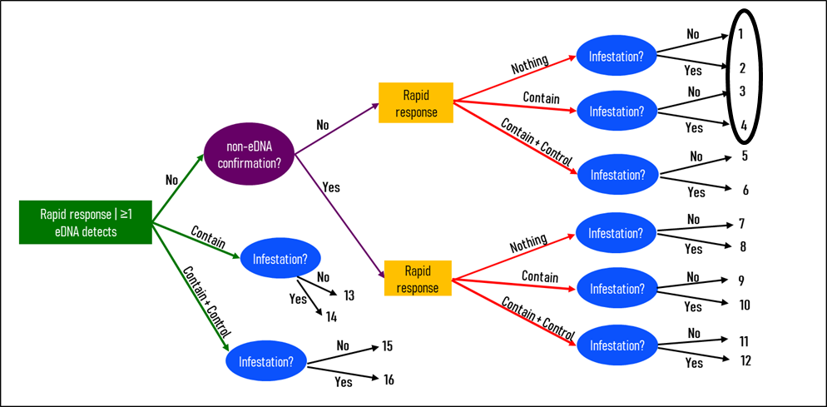
Consequences
16 possible outcomes
Likely outcome for objective attributes = score
empirical
modeled
literature
expert opinion
 |  | Protect water supply | Protect ecosystem |  | Maintain recreation | Maximize public support | Minimize costs
Outcomes |  | Mandate to meet demand | Spatial extent of infestation | Spread | Number of closures | Level of support | Dam costs | Management & sampling costs
Branch |  | % required supply delivered | % area infested | likelihood of spread | ramp-days | 5 point scale | $$ (thousands) | $$ (thousands)
1 |  | 100 | 0 | 0.01 | 0 | 3 | 450 | 40
2 |  | 100 | 40 | 0.01 | 0 | 1 | 450 | 40
3 |  | 100 | 0 | 0.29 | 1077 | 4 | 450 | 2016
4 |  | 100 | 40 | 0.01 | 1077 | 2 | 450 | 2016
Outcomes → Objectives

Slide 21
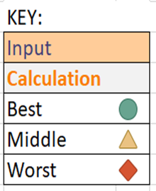
Tradeoffs & Optimize
 | Protect water supply | Protect ecosystem |  | Maintain recreation | Maximize public support | Minimize costs
 | Mandate to meet demand | Spatial extent of the infestation in Jordanelle | Spread outside of Jordanelle | Number of closures | Level of support | Infrastructure retrofit costs | RR management & sampling costs
Branch | % required supply delivered | % area infested | Utility | ramp-days | 5 point scale | dollars (thousands) | dollars (thousands)
1 | 100 | 0 | 0.01 | 0 | 3 | 450 | 40
2 | 100 | 40 | 0.01 | 0 | 1 | 450 | 40
3 | 100 | 0 | 0.29 | 1077 | 4 | 450 | 2016
4 | 100 | 40 | 0.01 | 1077 | 2 | 450 | 2016
Reduce likelihood of QZ mussel spread to other lakes
Close ramps → less recreation
Watercraft inspection → lower public support
"Preliminary Information-Subject to Revision. Not for Citation or Distribution."

Slide 22
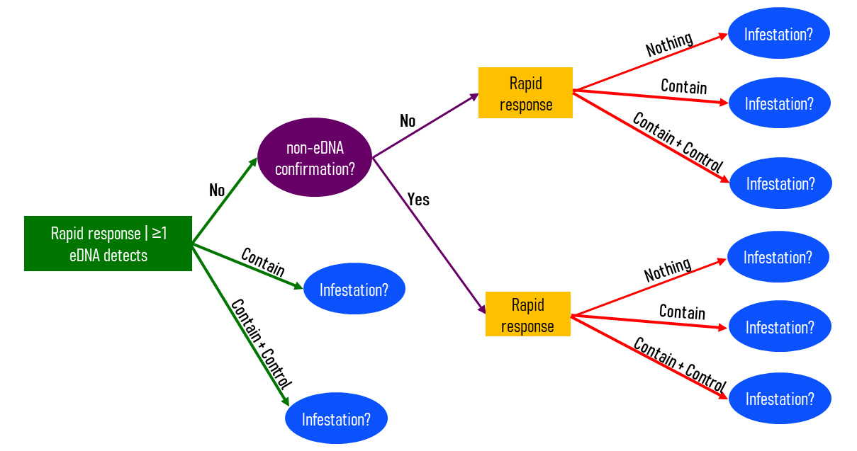
Tradeoffs & Optimize
Evaluate outcome sensitivity to assumptions
Public support = 10
Control costs too much and effect too uncertain
Reduce costs from $millions to $tens of thousands
Regional spread = 10

Slide 23
Decide & Take Action
In process…
Decision support not decision mandate

Slide 24
Next steps

Slide 25
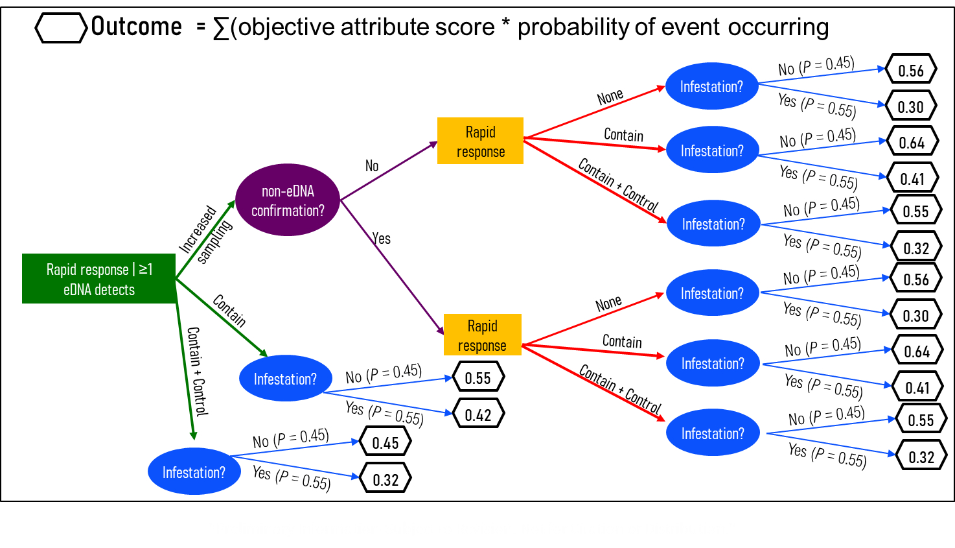
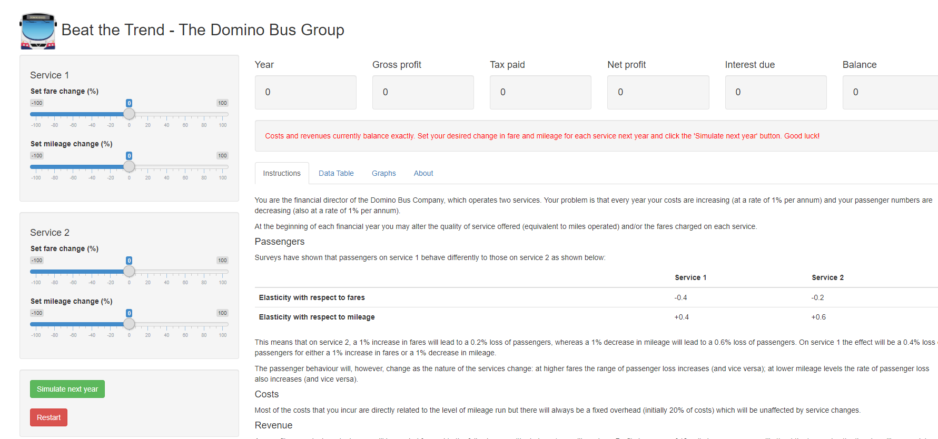
eDNA detections and EDRR
General template for decision process after eDNA early detections
Test & refine Jordanelle model in different system
Graphic user interface
‘app’
https://community.rstudio.com/

Slide 26
GSARP members
Case study like Jordanelle
Willing decision-makers & stakeholders
Fall 2021
In person (~ 5 days)
Virtual (~ten, 2hr meetings)
Benefits
Useful model specific to your system
Training in SDM

Slide 27
Thank you
Adam Sepulveda
USGS Northern Rocky Mountain Science Center
asepulveda@usgs.gov

