Slide 1
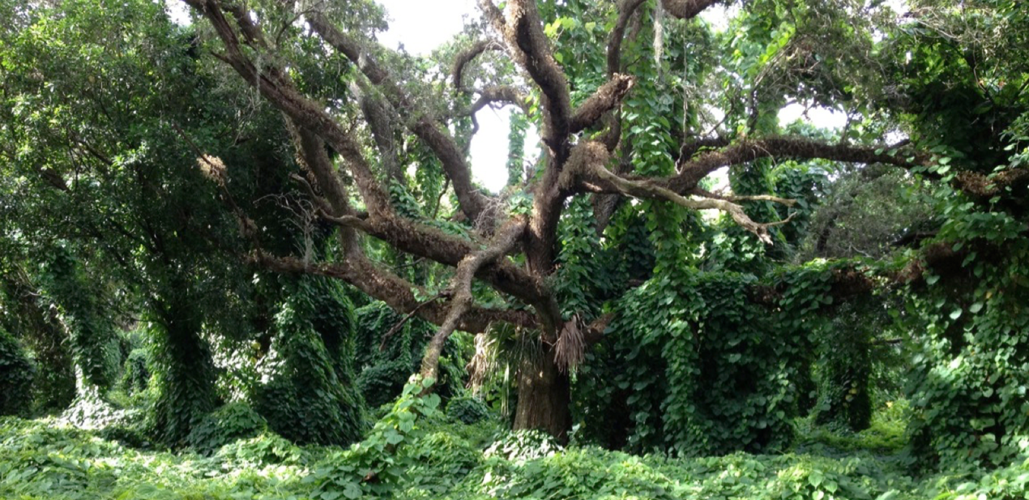
Using Horizon Scanning, rapid risk assessment, and consensus building identify invasive species threats to the state of Florida, U.S.
Deah Lieurance
Assistant Extension Scientist
Agronomy Department
University of Florida
Notes:
This presentation will take you through basic concepts in invasion ecology and can be presented as is, or pieces of this presentation may be used as an introduction to other invasive species extension content. This presentation focuses on plants. The photo is an air potato invasion in Broward county (Photo credit, D. Lieurance)

Slide 2
Context
Current approaches employed to predict and regulate invasive species in the U.S. occur post-introduction
30+ points of entry (airports, domestic and commercial ports) make Florida a gateway for introductions to the southeastern U.S.
There is an urgent need to identify unknown or emerging invaders so preventative measures can be implemented
Notes:
69 million tourists visited Florida in 2019

Slide 3
Goals
To provide a ranked list of invasive species threats (all taxa excluding microorganisms)
Identify pathways for arrival
Create a framework for other regions in the U.S.
Notes:
And hopefully influence policy

Slide 4
Meeting preparations

Slide 5
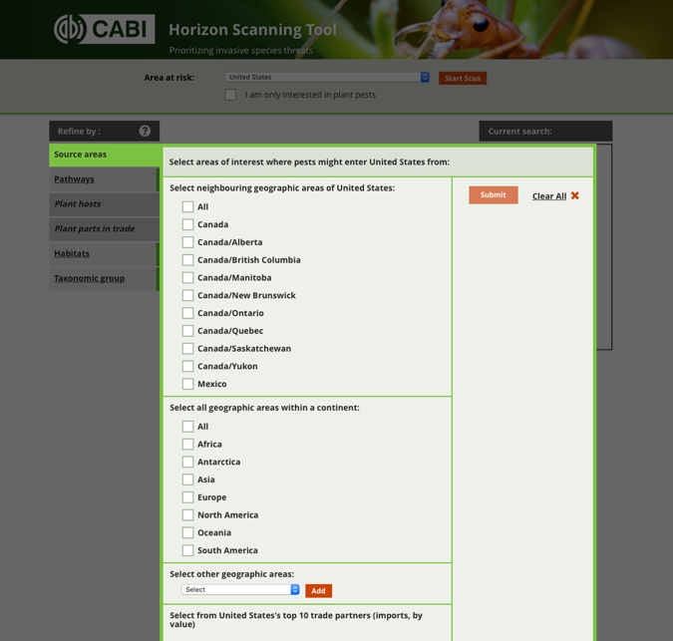
CABI Horizon Scanning tool
Information from CABI Compendia datasheets is used to generate a list
Include that are absent from the selected ‘area at risk’ but present in ‘source areas’
Initial list 9629 species
Divide into taxonomic groups
Remove species already in Florida
Rank by number of global records

Slide 6
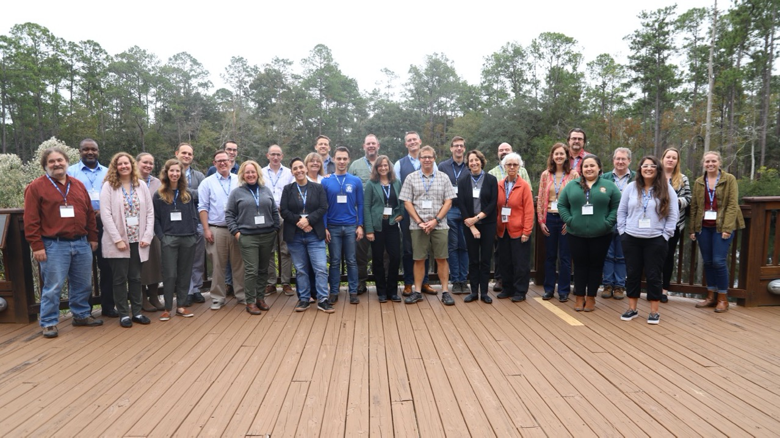
Participants of the Horizon Scanning workshop that took place December 11-12, 2019 in Gainesville, FL

Slide 7
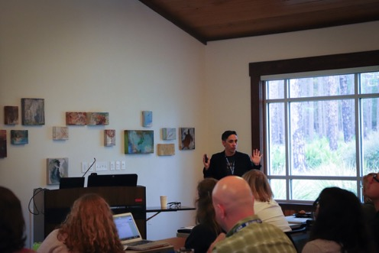
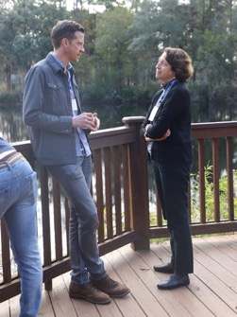
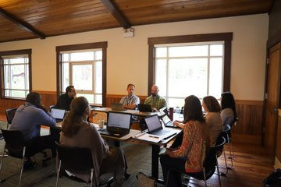
The Workshop
Presentations on the lists, pathways, rapid risk assessment tool
Group discussion to refine methods
Breakout sessions by taxonomic group to work on lists
Lists narrowed to between 100-250 species

Slide 8
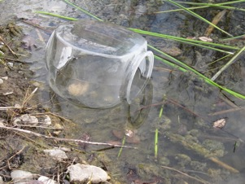
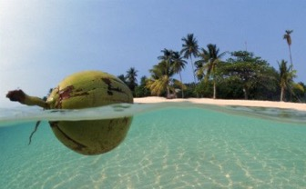
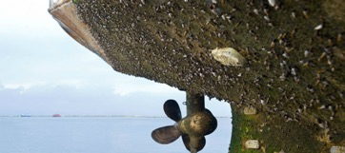
Pathways
Dispersal
Vector
Movement of commodity
Release in nature
Escape from confinement
Transport contaminant
Corridor
Unaided
Transport stowaway
https://mfame.guru/need-know-hull-fouling-intertankos-guide/
Harrower et al. 2018

Slide 9
Rapid screening tool
Confidence
For each likelihood score
An overall confidence estimate for the final score
high, moderate, low, very low

Slide 10
Criteria for scoring-Arrival
Closest observation to FL and closest online seller are outside of the US
Closest observation to FL is within the US, but not in the SE US, and the closest online seller to FL is outside of the US
Closest observation to FL and closest online seller to FL are within the US, but not in the SE US or closest observation to FL is in the SE US, but not in FL and the closest online seller to FL is outside the US
Closest observation to FL is within the SE US, but not in FL, and the closest online seller is within the US or the SE US, but not in FL
Closest observation to FL is within FL (but no more than 5 records)

Slide 11
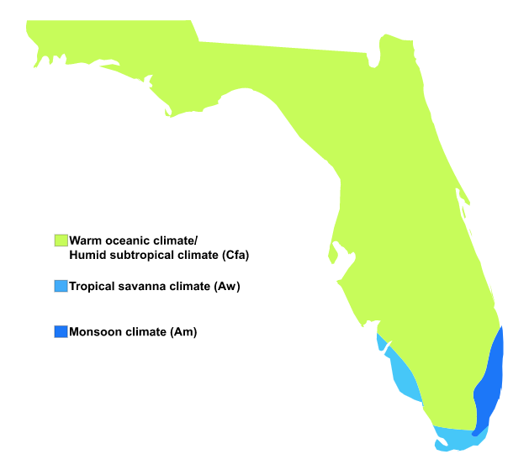
Criteria for scoring-Establishment
No observations in areas with matching Köppen-Geiger (KG) zones to FL
Few observations in one area with matching KG zones to FL
Many observations in one area or few observations in multiple areas with matching KG zones to FL
Many observations in multiple areas with matching KG zones to FL
Criteria for score 4 and evidence of a biological strategy that aid establishment or evidence of establishment in FL

Slide 12
Criteria for scoring-Impacts
A taxon is unlikely to cause negative impacts on the native biota or abiotic environment, human well‐being, or economic systems
A taxon is likely to cause (a) the replacement and local extinction of native species and will produce irreversible changes in the structure of communities and the abiotic or biotic composition of ecosystems or (b) local disappearance of a social or economic activity from all or part of the area invaded by the alien taxon or major effects to human health.
5.

Slide 13
Preliminary risk designations
>64 High Risk
27-63 Moderate Risk
<27 Low Risk

Slide 14
Review phase
All assessments receiving a score of 20 points or more were peer reviewed
Each taxonomic team was given time to read over reviewer comments and flag species requiring more discussion
Within taxa consensus reached via ZOOM
All High and Moderate risk species compiled for final consensus

Slide 15
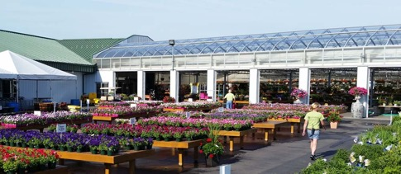
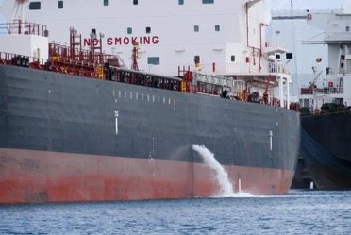
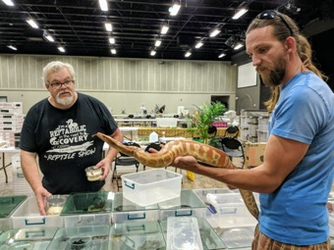
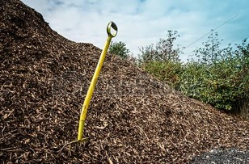
Preliminary results
Two prominent pathways identified
Escape from confinement (outlined in blue)
Transport contaminant (outlined in orange)
https://ggs-greenhouse.com/garden-centers
https://marinebiosecurity.niwa.co.nz/ballast-water-management-of-international-vessels/
https://www.cullmantribune.com/2019/05/20/exotic-pet-expo-returns-to-cullman/

Slide 16
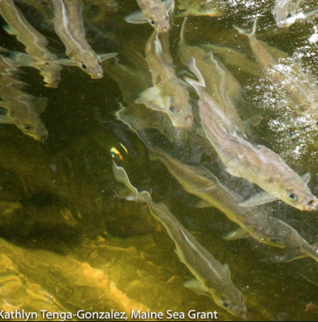
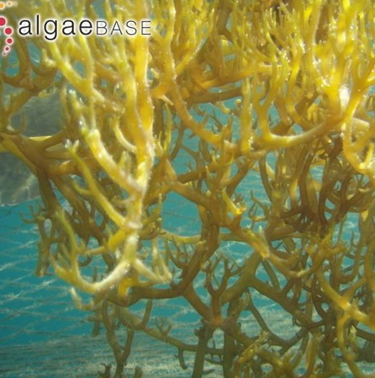
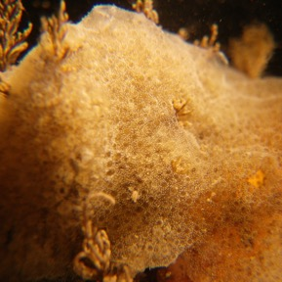
Preliminary results-Marine
Alewife
Alossa pseudoharengus
125
Agar agar
Kappaphycus alvarezii
100
Sea snot
Diplosoma listerianum
80
https://invasions.si.edu/nemesis
Release in nature,
corridor
Transport stowaway,
contaminant
Escape from confinement

Slide 17
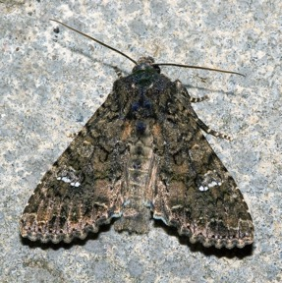
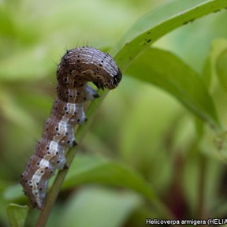
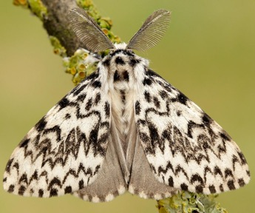
Preliminary results-Terrestrial invertebrates
Cabbage moth
Mamestra brassicae
100
Cotton bollworm
Helicoverpa armigera
100
Nun moth
Lymantria monacha
80
Olaf Leillinger
https://butterfly-conservation.org/moths/black-arches
Transport contaminant
Transport contaminant,
unaided
Transport stowaway,
contaminant

Slide 18
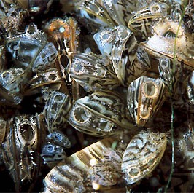
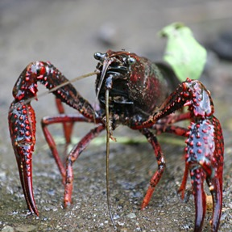
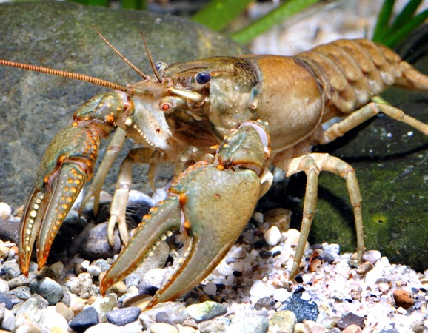
Preliminary results-Aquatic invertebrates
Zebra Mussels
Dreissena polymorpha
125
Red swamp crayfish
Procambarus clarkii
125
Virile crayfish
Faxonius virilis
100
GerardM
MikeMurphy
Escape from confinement,
release in nature
Transport contaminant
Escape from confinement,

Slide 19
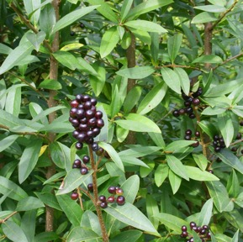
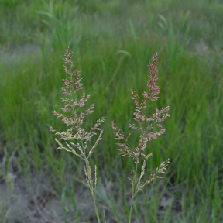
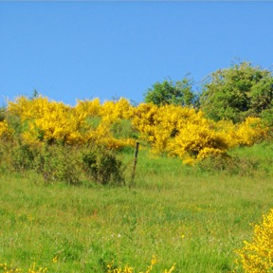
Preliminary results-Plants
Common privet
Ligustrum vulgare
100
Common bent
Agrostis capillaris
80
Scotch broom
Cytisus scoparius
80
Frank Vincentz
https://gobotany.nativeplanttrust.org
Escape from confinement,
release in nature
Transport stowaway,
contaminant
Escape from confinement

Slide 20
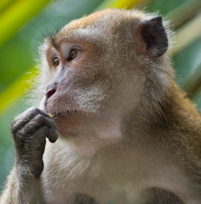
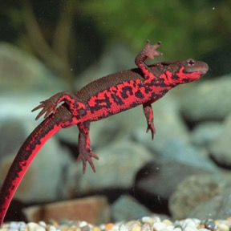
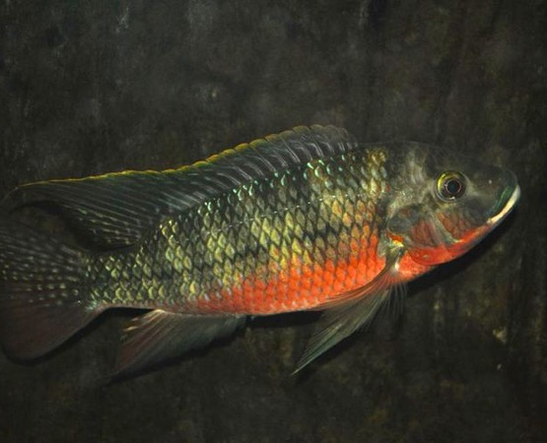
Preliminary results-Vertebrates
Crab-eating macaque
Macaca fascicularis
100
Japanese fire belly newt
Cynops pyrrhogaster
100
Redbelly tilapia
Tilapia zillii
100
André Ueberbach
https://www.thesprucepets.com
Escape from confinement
Release in nature
Escape from confinement
Escape from confinement

Slide 21
Next steps
Final consensus scheduled May 27, 2021
Collaborating with USGS to complete habitat suitability models for high risk species
Currently working on improving guidelines and validation of the rapid risk screening tool
Additional species will be screened and ranked in 2022
Lists will be revisited at regular intervals to add or subtract species as new information surfaces

Slide 22
Special thanks to
Team leaders
Marine—Don Behringer
Plants—Amy Kendig
Aquatic invertebrates—Lindsey Reisinger
Vertebrates—Christina Romagosa
Co-organizers
Susan Canavan
S. Luke Flory
Julie Lockwood

