Slide 1
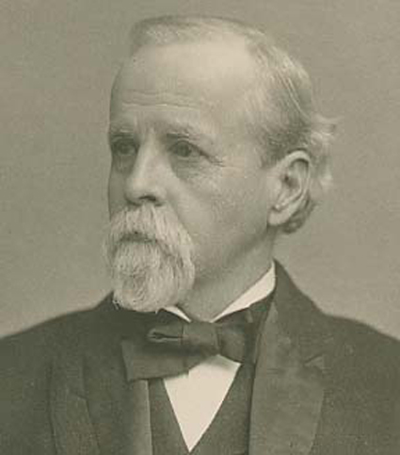
What the “Lacey Act” is and isn’t and status of Injurious Wildlife provisions (18 USC 42) Gulf and South Atlantic Regional Panel on Aquatic Invasive Species April 21, 2021
Susan Jewell
Injurious Wildlife Listing Coordinator
U.S. Fish and Wildlife Service HQ
Falls Church, VA
Notes:
Thank you for inviting me to give this presentation. My goal is to erase your confusion about what the Lacey Act is. Let’s see if I can do that! The photo is of John Fletcher Lacey, U.S. Representative from Iowa, who introduced the bill in 1900 that forever more became known as the Lacey Act. If only he knew how foresighted he was for conservation and how long his legacy would last! And, may I add, how long the confusion over his name would last!

Slide 2
Today’s exciting goals are:
Identify the difference between title 18 (injurious wildlife) and title 16 (wildlife and plant trafficking) and make clear what title 18 is and is not
Discuss the interstate transport court decision of 2017 and what that means
Discuss two bills regarding injurious wildlife that have been introduced recently and how they would clarify the interstate transport authority
Show a few slides on what is listed as injurious and the effectiveness of listing
Notes:
My 4 goals today are to identify the difference between title 18 (Injurious provisions) and title 16 (wildlife and plant trafficking) and make clear what title 18 is and isn't.
Discuss the interstate transport decision and what that means
Discuss the two bills have been introduced recently and what they would do
Show a few slides on success of injurious listing (my paper is in press in MBI).

Slide 3
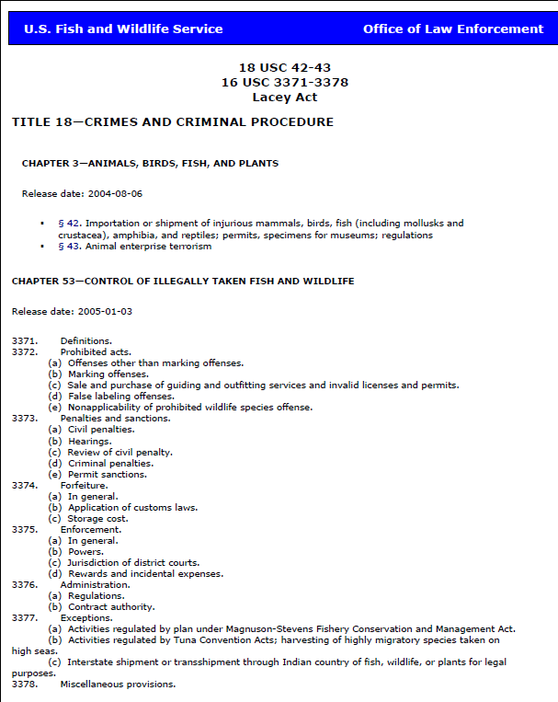
https://www.fws.gov/le/pdffiles/Lacey.pdf
TITLE 16 -- CONSERVATION
Notes:
First, here is a reason that some people may be confused about what the Lacey Act is because of this document. If you google Lacey Act FWS, this is what you will get. It’s from our Office of Law Enforcement and it was last updated 2/11/2006. I know you can’t read the whole page. This is the first page of 11 and it is the table of contents. The rest of the pages are the statute language. I want to say that I have utmost respect for our Office of Law Enforcement, but with limited resources, revising for updates and corrections is not a priority.
Errors: Chapter 53 is not under title 18—it is under title 16 “Conservation”
Title 18 of the United States Code is the main criminal code of the federal government of the United States. It deals with federal crimes and criminal procedure. Title 16 is in Conservation, which includes other things.
Later pages do not clearly distinguish what is under title 18 and what is under title 16. For example, the definitions appear to also apply to 18 USC 42, but they doesn’t.

Slide 4
What was the “Lacey Act”? 1900 – The first major national conservation statute
Two main purposes
“[T]o regulate the introduction of American or foreign birds or animals in localities where they have not heretofore existed”
This was primarily to stop the importation of wild mammals and birds that were harming American agriculture and wildlife
“[T]o prohibit the transportation by interstate commerce of game killed in violation of local laws”
This was primarily to protect U.S. native wildlife.
Notes:
The USDA reported to John Lacey two major problems that were happening to U.S. resources in the late 1800s –people were importing wild birds and mammals for various reasons and releasing them into the wild without consideration of the repercussions. For example, European starlings and English sparrows were imported by people who wanted to see the same birds that Shakespeare saw. But they reproduced out of control and were devastating American crops (they ate seeds, grains, fruits). Also, people were killing game birds and mammals in violation of a State law and getting away with it by crossing into another state.

Slide 5
FIFTY-SIXTH CONGRESS. SESS. I. CHS. 552. 553. 1900
“… To enlarge the powers of [USDA], prohibit the transportation by interstate commerce of game killed in violation of local laws, and for other purposes.”
Notes:
So Lacey got legislation passed that addressed both issues at the same time. The slide shows the 1900 act, which does not have his name attached. As you can see, it gives new authority to USDA in 1900, which stayed until 1940, when Congress gave the authority to the Dept of the Interior. I’m not going to show you much of the history, but the beginning shows where the confusion probably stemmed from. There was really no distinction between what we now have as two separate statutes. Here you see the overarching description, which includes what we now call the wildlife trafficking provision, and “for other purposes” which is now the injurious provisions.

Slide 6
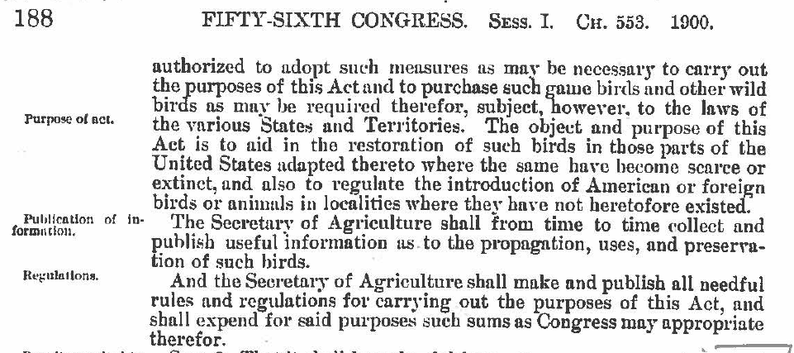
“. . . And also to regulate the introduction of American or foreign birds or animals in localities where they have not heretofor existed.”
Notes:
This is the immediate next page, showing one purpose of the act, which is the new injurious provisions.

Slide 7
“Sec. 3. Transportation of prohibited animals forbidden.”
“That it shall be unlawful for any person to deliver to any common carrier . . . to transport from one State or Territory to another State or Territory . . . any foreign animals or birds the importation of which is prohibited . . . Or killed in violation of the State . . .”
Notes:
Section 3 is where the confusion may have started, because it included interstate transport and included injurious species as well as native species in the same section.

Slide 8
1960 Amendments to Injurious Wildlife
Congress amended Lacey Act by adding:
fishes, mollusks, crustaceans, reptiles, and amphibians to the species that could be designated as injurious;
more categories of interests that could be affected as justification for designating species (injury to human beings, forestry, or to wildlife or wildlife resources of the United States);
exceptions under permit; and
the shipment clause rewording
Notes:
The next major amendments that added authority for title 18 were in 1960. It maintains existing language (except for a tweak of the shipment clause) and adds the new taxa, interests, and permit exceptions.
We will talk about the “shipment clause” in a few minutes.

Slide 9
What is covered NOW
Title 18 (Injurious)
Title 16 (trafficking)
Wild mammals, wild birds, fishes, mollusks, crustaceans, reptiles, and amphibians, or the offspring or eggs
(Does not specify whether alive or dead—that is done by regulation)
Any fish or wildlife, whether alive or dead, including without limitation any wild mammal, bird, reptile, amphibian, fish, mollusk, crustacean, arthropod, coelenterate, or other invertebrate, whether or not bred, hatched, or born in captivity, and includes any part, product, egg, or offspring thereof.
Any wild member of the plant kingdom, including roots, seeds, and other parts thereof . . . .which is indigenous to any State and either CITES-listed, listed pursuant to any State law for conservation
Notes:
Title 18 is pretty basic, but title 16 is very comprehensive.

Slide 10
Prohibitions
Title 16 (trafficking)
Title 18 (Injurious)
Importation and transport between shipping clause jurisdictions (of injurious wildlife)
Unlawful to import, export, sell, acquire, or purchase fish, wildlife or plants that are taken, possessed, transported, or sold in violation of any law, treaty, or regulation of the U.S. or in violation of any Indian tribal law; or in interstate or foreign commerce involving any fish, wildlife, or plants taken, possessed, or sold in violation of State or foreign law.
Notes:
Again, title18 – is basic, prohibitions do not include export, sale, possession, etc. Title 16 is very broad!

Slide 11
Penalties
Title 18 (Injurious Wildlife)
Misdemeanor
Strict liability for violations
Up to $5,000/$10,000 fine or up to 6 months jail or both
Title 16 (Trafficking)
Class A misdemeanor
“Knowingly” for violations
Up to $100,000/$200,000 fine or 1 year in jail or both
Other civil, criminal, and forfeiture penalties
Notes:
Title 18 – strict liability standard– you don’t have to know what the law is, if you violate it, it doesn’t matter that you didn’t know. Liable regardless of what person’s intent or mental state was when committing the action.
Title 16 – misdemeanor penalties section 3373 (d) (2) any person who knowingly violates 3372 (for example, has knowledge that he or she is transporting zebra mussels AND in the exercise of due care should have known that the mussels were taken transported possessed or sold in violation of some law, is a Class A misdemeanor.
Lacey Act provides Civil, criminal, and forfeiture penalties

Slide 12
Amendments Adding Taxa of Organisms
Title 16 (trafficking)
Title 18 (Injurious)
1960 – added fishes, reptiles, amphibians, mollusks, and crustaceans.
1969 – added amphibians, reptiles, mollusks, and crustaceans NATIVE
1981 – added endangered native plants, fishes
2008 – added trees and plant parts
Notes:
Confusion on when taxa of organisms were added. By the way, some of these amendments are called the Lacey Act Amendments of 1981, and the Lacey Act Amendments of 2008. The punchline is coming in a few slides.

Slide 13
Interstate transport
1900 – Prohibits interstate transport of injurious wildlife
1960 – (18 U.S.C. § 42(a)(1)) states, “The importation into the United States, any territory of the United States, the District of Columbia, the Commonwealth of Puerto Rico, or any possession of the United States, or any shipment between the continental United States, the District of Columbia, Hawaii, the Commonwealth of Puerto Rico, or any possession of the United States . . . is hereby prohibited.” The latter clause is known as the “shipment clause.”
Notes:
Now let’s talk about the interstate transport aspect of injurious wildlife. The intent of Congress in 1900 that I showed you before showed that it was unlawful to transport from one State to another any foreign animals or birds the importation of which was prohibited. The 1960 amendment uses the language “between.” For the last few decades, the Department of the Interior interpreted the “between” part as between States, considering the continental United States as separate entities, not one collective entity.

Slide 14
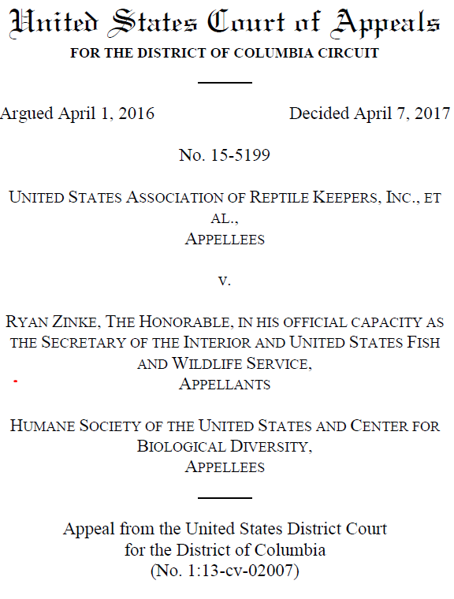
Implementation of the D.C. Circuit Court Decision in United States Association of Reptile Keepers, Inc. v. Zinke, No. 15-5199 (D.C. Cir. April 7, 2017)
Notes:
Now for the court case that got us into this discussion. We were sued in 2013, and the case ended in appeals court in 2017. The case was based on complaints about our large constrictor snake regulation, but the only complaint we lost was on our interpretation of the statute regarding interstate transport.

Slide 15
The Circuit Court’s Decision
Notes:
This is the appeals court’s decision. The judges keyed in on the word “between,” saying that the continental United States is one unit, and the other jurisdictions are separate.

Slide 16
S. 626 Rubio and Schatz
March 9, 2021
A bill to amend title 18, United States Code, to enhance protections against the importation, and transport between States, of injurious species, and for other purposes.
“§42. Importation or shipment of injurious mammals, birds, fish (including mollusks and crustacea), amphibia, and reptiles; permits, specimens for museums; regulations
(a)(1) The importation into the United States, any territory of the United States, the District of Columbia, the Commonwealth of Puerto Rico, or any possession of the United States, or transport between the States, the District of Columbia, Hawaii, the Commonwealth of Puerto Rico, or any possession of the United States, of the mongoose of the species Herpestes auropunctatus; of the species of so-called "flying foxes" or fruit bats of the genus Pteropus; of the zebra mussel of the species Dreissena polymorpha; of the quagga mussel of the species Dreissena rostriformis or Dreissena bugensis; of the bighead carp of the species Hypophthalmichthys nobilis; and such other species of wild mammals, wild birds, fish (including mollusks and crustacea), amphibians, reptiles, brown tree snakes, or the offspring or eggs of any of the foregoing which the Secretary of the Interior may prescribe by regulation to be injurious to human beings, to the interests of agriculture, horticulture, forestry, or to wildlife or the wildlife resources of the United States, is hereby prohibited.”
[Also includes language for emergency listing and prohibition of importation and interstate transportation for species not native to the United States unless already imported in more than minimal quantities or Secretary determines it does not pose a risk.]
Notes:
Here is a bill that was just recently introduced by Senators Rubio and Schatz, so it’s bipartisan. The language inserted into the bill is intended to clarify the interstate issue. It also adds emergency listing authority to the end of the paragraph, which is not shown here. And it also adds a new category for nonnative species not yet in trade in the United States, but that’s not the focus of this presentation.
Advantages to amending to 18 USC 42:
More likely to get passed because the changes are minimal. By the way, the short title of this is “The Lacey Act Amendments of 2021” Referred to the Committee on Environment and Public Works.

Slide 17
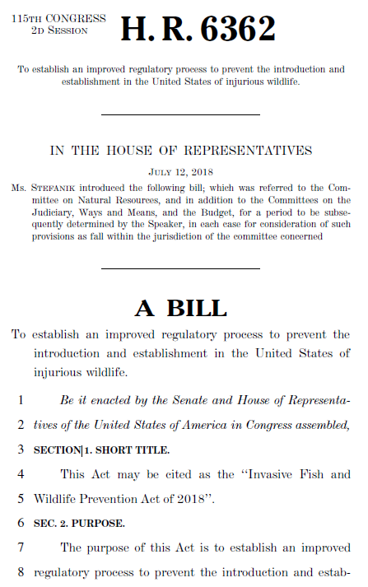
Notes:
This was HR 6362, a bill that would replace the current injurious provisions, although the existing injurious species would be grandfathered in. It would have its own name “Invasive Fish and Wildlife Prevention Act,” so it wouldn’t be confused with the “Lacey Act” name. It was in the 115th Congress but has not been reintroduced. It could be at any time.
It’s also bipartisan, with Sen. Kirsten Gillibrand of NY. It would expand the statute more in line with the scope of the Endangered Species Act. It would have a set of definitions; new authorities, such as any listing any invertebrate taxa; fee collection for live wildlife shipments; grants to States and Indian tribes. Also includes a section on prevention of wildlife pathogens and parasites, but that may or may not be in future versions.
https://www.congress.gov/115/bills/hr6362/BILLS-115hr6362ih.pdf

Slide 18
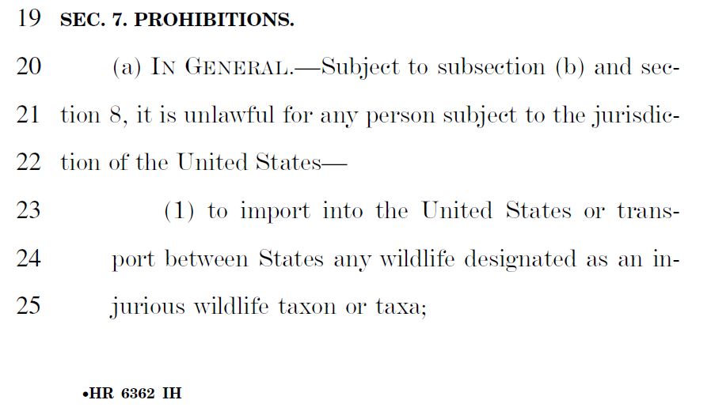
Interstate Transport in HR 6362
Notes:
This is how HR 6362 would change the interstate transport clause. The bill defines States elsewhere to include Territories and Commonwealths, etc. so transport between those jurisdictions would be prohibited as well. In fact, there is a whole section on definitions, which the current injurious statute does not have.

Slide 19
Summary of Injurious Species Listed
Taxa | Number of Species
Mammals | 96
Birds | 4
Fishes (including 228 salmonids for pathogen) | 417
Mollusks | 2
Crustaceans | 6
Reptiles | 10
Amphibians (including 201 salamanders for pathogens) | 201
TOTAL | 736
Current Injurious Wildlife Regulations are found in
50 CFR 16.11-15
Notes:
Now for a few slides about what is listed as injurious. This is a summary by major taxa of all the species that are currently listed. If you want to see the whole list, you can find it on our website. Of the 736 total, 307 species listed for invasiveness—the salmonids and salamanders were listed because they are carriers of pathogens harmful to wildlife.

Slide 20
Effectiveness of Injurious Wildlife Listing
307 (total) – 19 (established) = 288 species
not established at listing
94% listed preemptively
None of those species has established since listing.
Notes:
So, 19 out of 307= 288 species were not established at the time of listing
We listed them before it was “too late”. However, we have reasons for listing species after they establish, and they are explained in my recent paper.

Slide 21
In summary . . .
The Lacey Act started as one statute and now is two that must be considered separately.
Injurious wildlife is under title 18 (18 U.S.C. 42), covers only vertebrates, mollusks, and crustaceans for import; strict liability standard.
Wildlife and plant trafficking is under title 16 (16 U.S.C. 3371-3378), includes all wildlife and plants, parts, alive or dead; import, export, sale, receive, acquire, etc.; knowingly standard.
The lack of interstate transport prohibition authority for injurious was decided by D.C. Circuit Court in 2017; applies to all injurious wildlife rules (title 18).
Two types of bills have been introduced in Congress that would clarify the interstate prohibition authority.
We know that listing high-risk species is effective when done preemptively, but there are reasons for listing established species, too.
We appreciate your interest in improving the injurious wildlife listing authority!

Slide 22
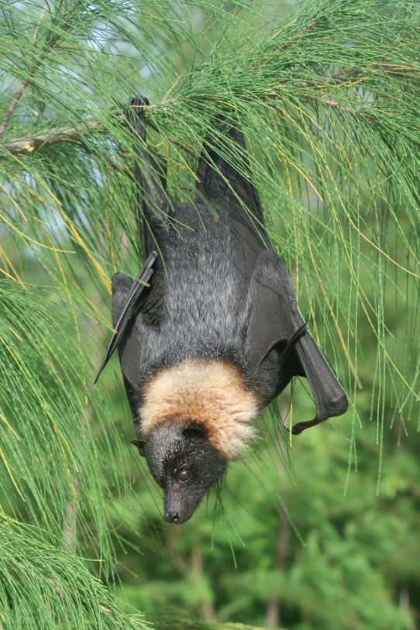
Questions?
susan_jewell@fws.gov
https://www.fws.gov/injuriouswildlife/
Mariana fruit bat,
listed since 1900
Notes:
Thank you, and I hope you are not more confused than ever!

Slide 23
Since its enactment in 1900, a principal “object and purpose” of the Lacey Act has been “to regulate the introduction of American or foreign birds or animals in localities where they have not heretofore existed.” Lacey Act, ch. 553, § 1, 31 Stat. 187, 188 (1900) (codified as amended at 16 U.S.C. § 701).
Notes:
From page 3 of the Circuit Court’s decision. Keeping this in mind for what Congress’s intent was in 1900. Italics mine.

Slide 24
Title 16 Trafficking NOT Title 18 Injurious
Notes:
Penalties for -
The penalty for an injurious wildlife Lacey Act violation is up to six months in prison and a $5,000 fine for an individual or a $10,000 fine for an organization.

Slide 25
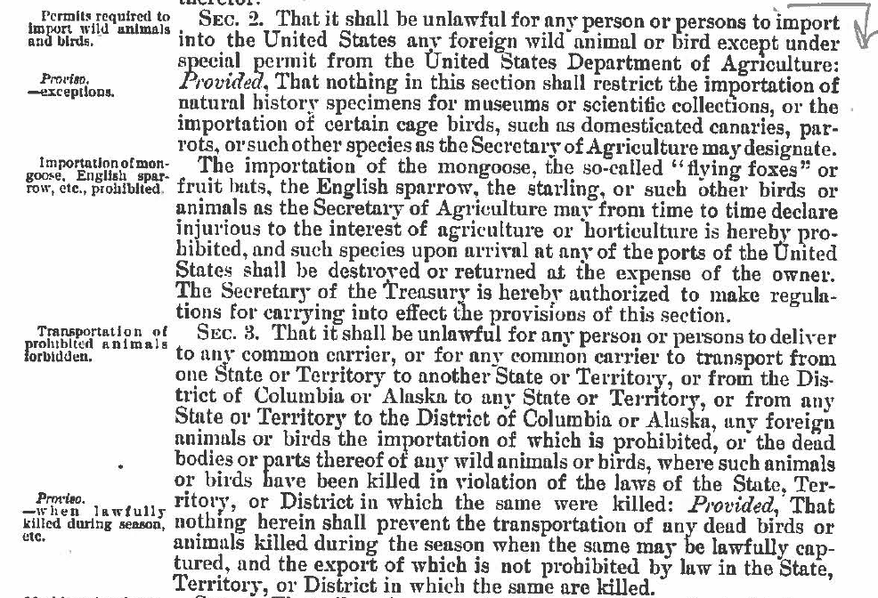
Notes:
It is further explained in Section 2—what is prohibited from importation, basically any wild bird or mammal (“animal”).
No wild bird or mammal could be imported—if you’re wondering why so few invasive species the first half of the last century, there’s your answer. Injurious species were not allowed in under any circumstance. No permits!
Section 3 is where the confusion may have started, because it included interstate transport and included injurious species as well as native species.

Slide 26
Current statute
§42. Importation or shipment of injurious mammals, birds, fish (including mollusks and crustacea), amphibia, and reptiles; permits, specimens for museums; regulations
(a)(1) The importation into the United States, any territory of the United States, the District of Columbia, the Commonwealth of Puerto Rico, or any possession of the United States, or any shipment between the continental United States, the District of Columbia, Hawaii, the Commonwealth of Puerto Rico, or any possession of the United States, of the mongoose of the species Herpestes auropunctatus; of the species of so-called "flying foxes" or fruit bats of the genus Pteropus; of the zebra mussel of the species Dreissena polymorpha; of the quagga mussel of the species Dreissena rostriformis or Dreissena bugensis; of the bighead carp of the species Hypophthalmichthys nobilis; and such other species of wild mammals, wild birds, fish (including mollusks and crustacea), amphibians, reptiles, brown tree snakes, or the offspring or eggs of any of the foregoing which the Secretary of the Interior may prescribe by regulation to be injurious to human beings, to the interests of agriculture, horticulture, forestry, or to wildlife or the wildlife resources of the United States, is hereby prohibited. All such prohibited mammals, birds, fish (including mollusks and crustacea), amphibians, and reptiles, and the eggs or offspring therefrom, shall be promptly exported or destroyed at the expense of the importer or consignee. Nothing in this section shall be construed to repeal or modify any provision of the Public Health Service Act or Federal Food, Drug, and Cosmetic Act. Also, this section shall not authorize any action with respect to the importation of any plant pest as defined in the Federal Plant Pest Act,1 insofar as such importation is subject to regulation under that Act.
Notes:
This is the current statute. Advantages to amending to 18 USC 42 to fix the interstate transport authority:
It’s more likely to get passed because the changes would be minimal. I will show in next slide how it could work.
Disadvantages to amending:
Language gets confusing when amendments keep getting added on. See how far apart the subject and verb are in the current statute because everything is squeezed in between, such as new species Congress adds to the statute. If it’s just the small change in interstate language, that is minimal.

Slide 27
Current status of species with established populations in the United States at the time of their listing as injurious (N=19), with the year each listing took effect, placed under the category of listing effectiveness. Species that spread by both human-mediated and natural means were counted only once, categorized by the more prominent pathway in establishing populations in new disconnected areas.
Species remaining within original State(s) where established when listed “Effective” | Species that spread after listing
 | To new States by human- mediated transport “Ineffective” | To new States naturally “Not applicable”
Mongoose, small Indian 1952 | Rabbit, European 1952 | Crab, Chinese mitten 1989
Bulbul, red-whiskered 1968 | Mussel, zebra 1990 | Carp, black 2007
Sparrow, Java 1968 | Snakehead, northern 2002 | Carp, silver 2007
Catfish, walking (Clarias batrachus) 1970 |  | Carp, bighead 2010
Catfish, walking (C. fuscus) 1970
Snake, brown tree 1990
Snakehead, blotched 2002
Snakehead, bullseye 2002
Python, Burmese 2012
Python, Northern African 2012
Zander 2016
Mussel, quagga 2018
Notes:
And now a few slides about the effectiveness of injurious listing. It’s a table I borrowed from a paper that I published a few months ago with Pam Full, who most of you know. We were looking at the effectiveness of injurious wildlife listing based on the whether or not a species was established at the time of listing, and if not established species subsequently became established. Only 19 species of a total of 307 were established at the time of listing, and they are still established. These are the species that the public mostly hears about and why many people assume we usually list after it’s too late to prevent establishment. We did not analyze whether the interstate prohibition was effective, only this superficial look, which shows that some species spread to other States. However, all but the rabbit are aquatic and can move on their own.

Slide 28
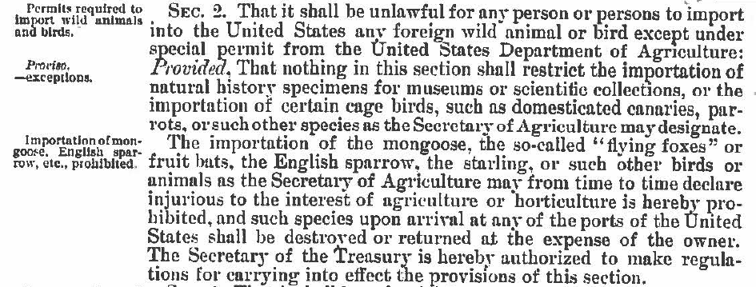
“Sec. 2. Permits required to import wild animals and birds. . . Importation of mongoose, English sparrow, etc. prohibited.”
Notes:
It is further explained in Section 2—what is prohibited from importation, basically any wild bird or mammal (“animal”).
No wild bird or mammal could be imported—which could explain why so few invasive species got a start in the first half of the 20th century. Injurious species were not allowed in under any circumstance. No permits!

