Slide 1
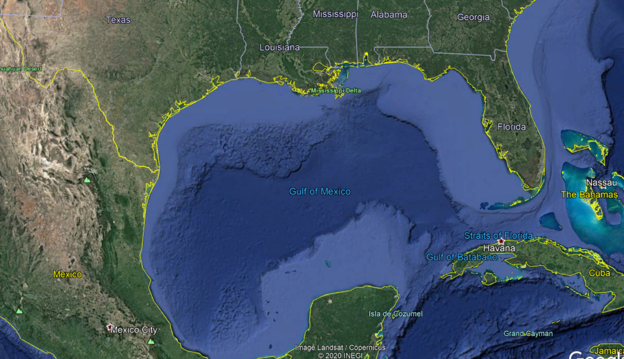
Gulf of Mexico Invasive species forecasting
Katie O’Shaughnessy
21 April 2021
Credit: GoogleEarth
Notes:
Hi everyone, I’m KO, thanks for inviting me to talk to you today about our invasive spp forecasting project we are doing in the Gulf of Mexico. I’m former National Academy of Sciences Science policy Fellow placed at TX Parks and Wildlife Coastal Fisheries. My fellowship was unfortunately only 12 months, so I’ve since moved on. But I am still the main contact for this project …since we have not completed this project yet, I will just be giving you an overview of our methods and what we have accomplished to date.

Slide 2
(western) Gulf of Mexico Invasive species forecasting
Photo Credit: GoogleEarth
Notes:
I ‘d like to first clarify that our group is not assessing the entire Gulf coast. There is another group assessing potential invasives in Florida - our group is essentially covering the western side of the Gulf. We are viewing our risk assessment area as an extension of FLs risk assessment area to get a complete picture of potentially invasive spp in the entire Gulf.

Slide 3
Forecasting/horizon scanning
This process in the context of invasive species prioritizes the threat posed by species that are absent or not yet widely spread in a risk assessment area and is a vital part of invasive species management and an essential element of an early warning system.
Copp et al., 2007; Genovesi et al., 2010; Roy et al. 2014
Notes:
So what I mean when I say forecasting for potentially invasive spp or also known as horizon scanning, this is prioritizing the threat…
For example, in Europe, The European Union Regulation on invasive alien species established a framework for action to prevent, minimise and mitigate the adverse impacts of invasive spp, and it focusses on the development of a list of invasive spp of EU Concern. The framework uses horizon scanning techniques and employs the help of dozens of scientists across the 27 member states to update that list every 10 years, and as such, is now an accepted component of invasive spp management.

Slide 4
Organizing Team
Wes Daniel – USGS, Nonindigenous Aquatic Species (NAS)
Leslie Hartman – Texas Parks & Wildlife, Coastal Fisheries
Monica McGarrity – Texas Parks & Wildlife, Inland Fisheries
Hanna Bauer – Texas Parks & Wildlife, Coastal Fisheries
Katie O’Shaughnessy – former Texas Parks & Wildlife, Coastal Fisheries
Notes:
I want to start by acknowledging our organizing team, who have really helped get this project off ground. SO thank you to Wes, Leslie, Monica and Hanna.

Slide 5
Co-authors
Julie Anderson-Lively
Wayne Bennett
Jorge Brenner
Alli Candelmo
Gordon Copp
Jess Dutton
Alex Fogg
Steve Geiger
Joe Goy
Steve Kolian
Tim Lyons
Matt McClure
Ashley Morgan-Olvera
Mike Norberg
Scott Porter
Elizabeth Robinson
Paul Sammarco
Lorenzo Vilizzi
Mary Wicksten
Notes:
Obviously we could not have done this without the expertise and knowledge from all of our species experts, who are located across the Gulf of Mexico states and specialising in ….

Slide 6
Major taxonomic groups
Ascidians
Bivalves
Bryozoans
Corals and Anemones
Decapods
Echinoderms
Elasmobranch
Fish
Gastropods
Notes:
…9 major taxonomic groups.

Slide 7
Research question
What species are likely to be introduced, establish, and cause ecological and/or socio-economic harm to coastal and marine habitats in the risk assessment area over the next decade?

Slide 8
Risk assessment area
Northern Gulf of Mexico, omitting FL
Estuarine, coastal and marine habitats out to the edge of the continental shelf
No “deep water” species
Photo Credit: GoogleEarth

Slide 9
Overall objectives
Develop methods to assess potentially invasive species in the nGoM which can be repeated every 10 years
Produce a “watch list” of the highest risk potentially invasive species
Publish results in academic journal
Notes:
We viewed this not only as a project in which to obtain useable results but also as a pilot project where we kind of work out the kinks and streamline the methods so that this work can be done every decade.

Slide 10
General methods
Consensus method –
Discussions that provide a robust means of collaborative decision-making among experts leading to prioritization of species
Notes:
So we wanted to take a combined approach where we use both a discussion-based decision-making technique, like the approach used by Helen Roy and others during their horizon scan for invasives in the UK

Slide 11
General methods
Structured, electronic decision-support tool
Notes:
And a more systematic and structured approach like the one we see with the Aquatic Sppecies Invasiveness Screening Kit – or AS-ISK. This tool was developed using the screening module from the European Non-native spp in Aquaculture risk scheme + used the structure of the FISK tool which I’m sure many of you are familiar with. The AS-ISK was created to be in full compliance with the minimum requirements for use with the EU regulations on invasive spp of Union concern as described in Roy and others from 2018. …I’ll get into a bit more detail on the AS-ISK tool in a moment, but first I want to talk about the phases of our project and how we drew up our initial species lists.

Slide 12
Our project
Initial species list
Formal risk assessment & review process
Group discussions
Ranked list of potentially harmful invasive species
Structured approach
Consensus
Notes:
So our combined approach consists of starting with an initial spp list, followed by a formal risk assessment and review, then we get into groups and discuss the outcomes of those risk assessments, and finally from discussions, we draft a list of potentially harmful invasive spp.

Slide 13
Five phases of the project
Initial species list
Narrow down initial species list
Review
Ranked list of species
Group discussions
Formal risk assessment
1
2
3
4
5

Slide 14
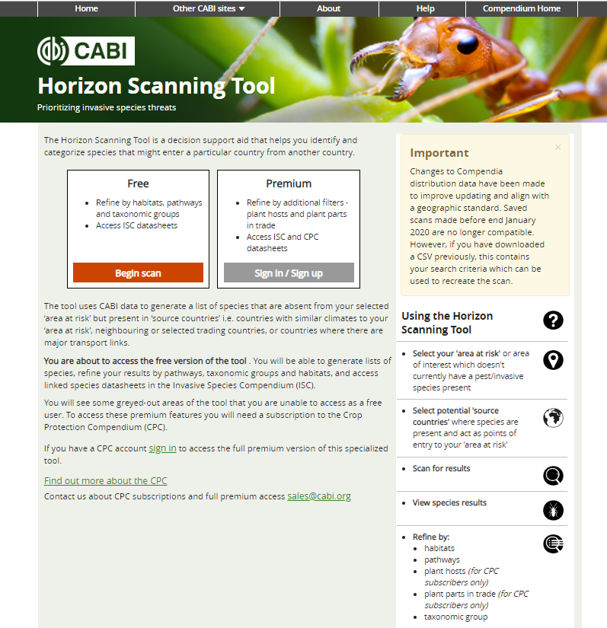
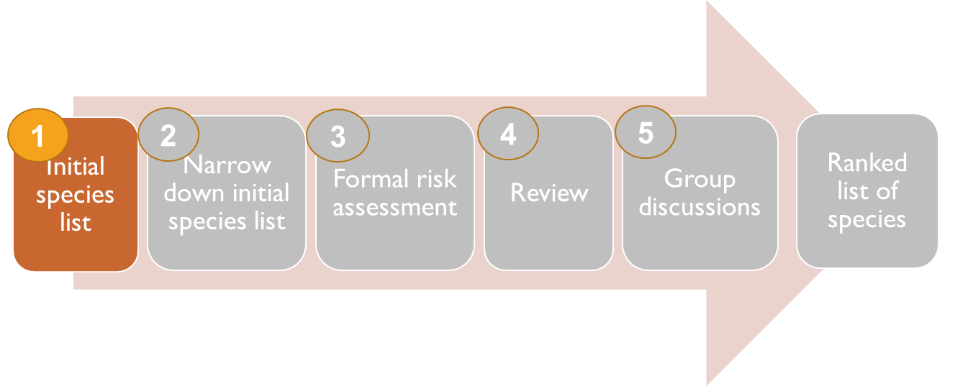
developing Initial Species List
CABI horizon scanning tool
Uses CABI data to generate a list of species that are absent in the risk assessment area but present in areas with similar climates
Invasive Species Compendium
Notes:
So the first phase of developing an initial spp list consisted of using the CABI horizon scan tool with nGoM as the risk assessment area to generate a list of spp: The tool uses CABI data to generate a list of species that are absent from your selected ‘area at risk’ but present in ‘source countries’ with similar climates to your ‘risk assessment area’, neighbouring or selected trading countries, or countries where there are major transport links."

Slide 15
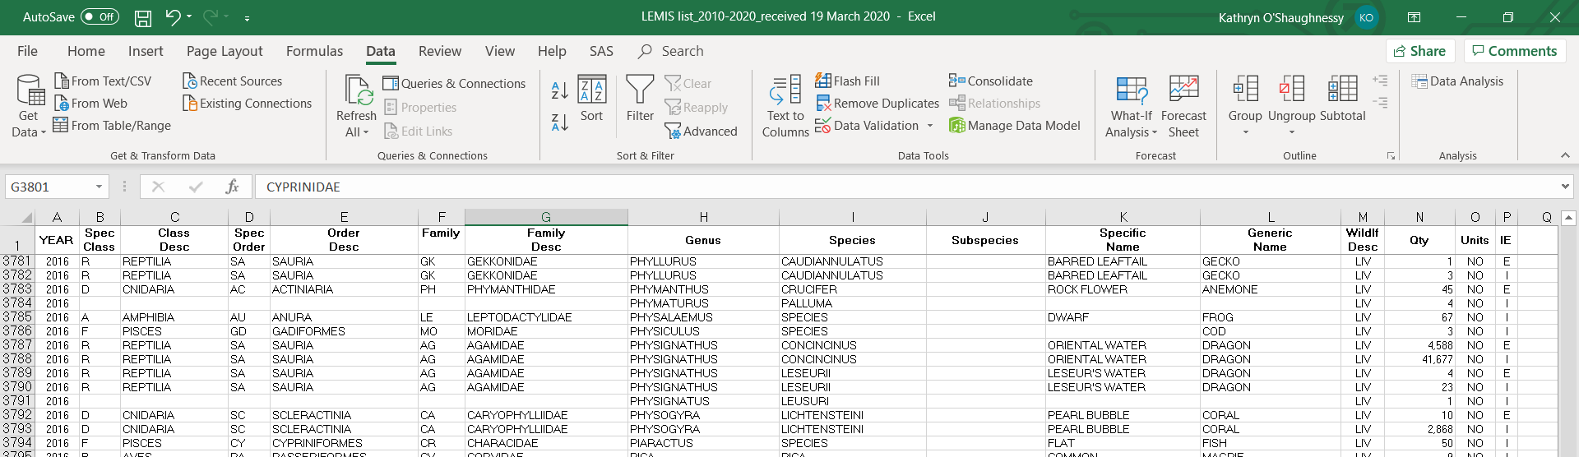
developing Initial Species List
LEMIS list (Law Enforcement Management Information System) -Provided by US Fish and Wildlife, Office of Law Enforcement
-List of species imported to US over the years 2015-2019
Notes:
We then requested a list of imported speces into the US for the years 2015-2019 from the law enforcement management information system, and added any spp from this list to our CABI list

Slide 16
developing Initial Species List
List of species was cross checked with the Nonindigenous Aquatic Species (NAS) Database and Gulf Base, which identifies species that are already established
-Established species were removed
Notes:
We then cross checked our list of species with those in the NAS and GulfBase databases, and removed species listed as already established

Slide 17
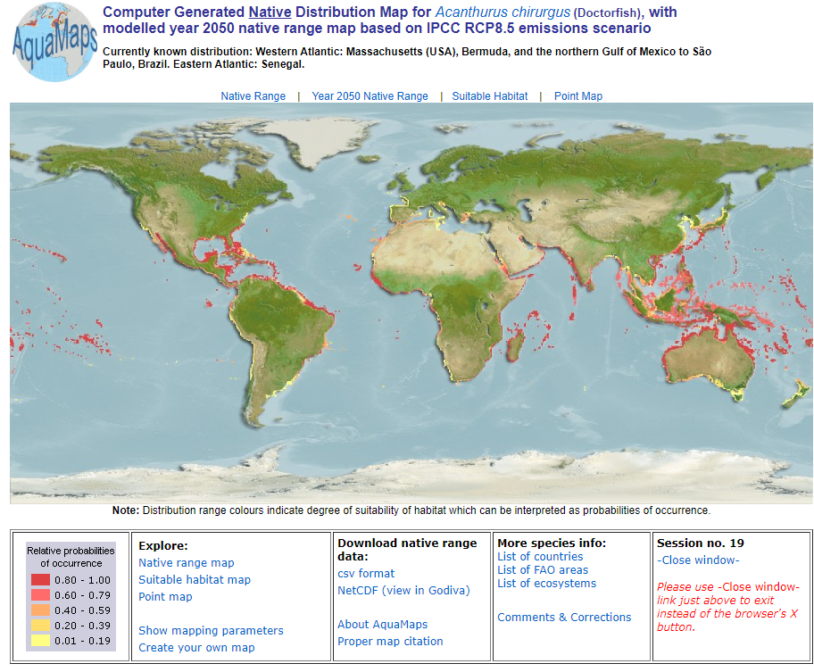
developing Initial Species List
Remaining species were checked in FishBase or SeaLifeBase.
These databases use AquaMaps to model matching habitat/ climate.
Notes:
Remaining species were checked in FishBase or SeaLifeBase. These databases use AquaMaps to model matching habitat/ climate. All species were checked to see if the GoM provides suitable habitat for their establishment. And if it was clear that the GoM does not provide suitable habitat for a species, that species was removed.

Slide 18
developing Initial Species List
Smithsonian database
NEMESIS database
Obis database
General internet searches
Published literature
Aquarium shop visits
Notes:
We pretty much topped this off with running the species through the Smithsonian, nemesis and Obis databases to gather more information. We also did general internet searches and looked through relevant published literature for species that were relatively data-poor. And finally, I visited a few aquarium shops in Texas to get an idea of whether or not we may have missed any popular aquarium species.

Slide 19
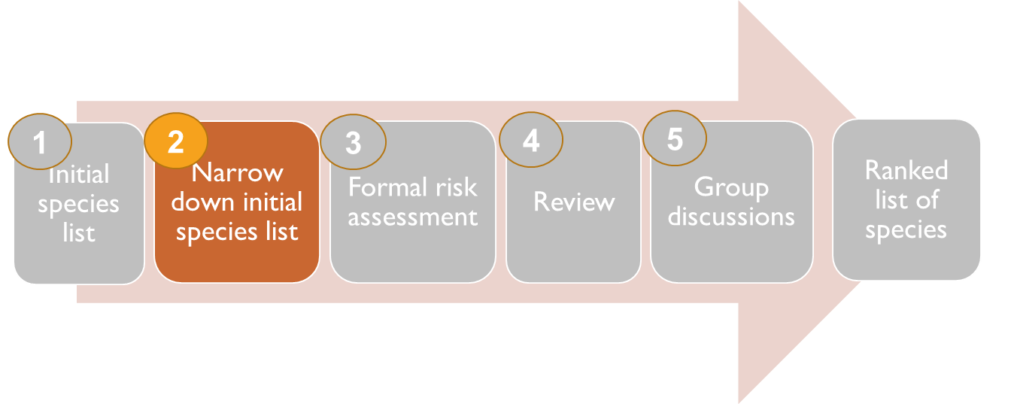
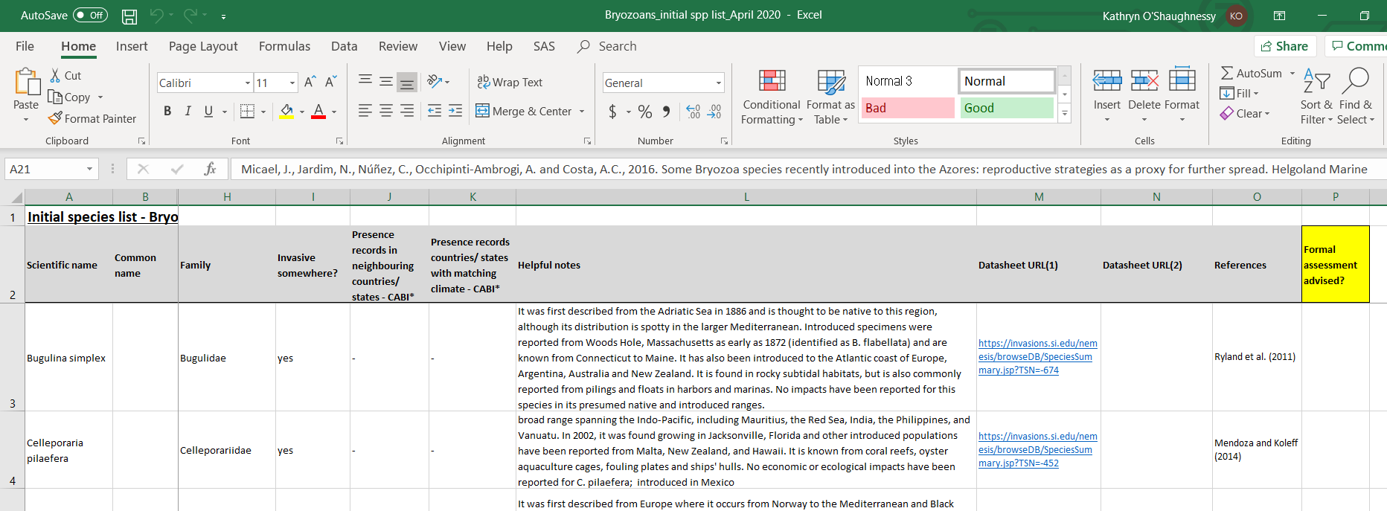
Narrowing initial Species List
Likelihood of introduction?
Likelihood of establishment?
Likelihood of ecological or socio-economic harm?
Known to be invasive elsewhere?
Does suitable habitat occur in the RA area?
Does the organism have attributes that indicate it could be invasive?
Notes:
Finally …we get to the phase where the organizing committee gets to hand off some of the work. So this is a snapshot of a spreadsheet that you would have received from me if you were one of our experts responsible for assessing species. It’s a list of initial spp in which we provided as much information as possible from all the sources we reviewed in the first phase of the project. The idea was that experts would be familiar with many of the species on their lists. But even if they were not, they would have all the information available to them, including relevant databases and references. We asked the experts to combine their expertise with information regarding likelihood of introduction, establishment and possibility of causing ecological or socio-economic harm for each spp. We also provided the experts with some additional questions to help facilitate a decision, such as is the spp known to be invasive elsewhere, is there suitable habitat in the nGoM and does the spp have invasive attributes?. Given all that information and the question prompts, we then asked the experts to narrow down the list to the spp they thought might invade and cause harm, and thus, would need a formal risk assessment done.

Slide 20
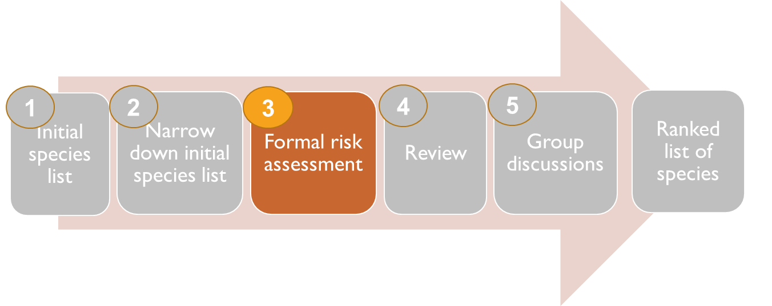
Formal Risk Assessment
Aquatic Species Invasiveness Screening Kit (AS-ISK v2.1)
https://beta.cefas.co.uk/services/research-advice-and-consultancy/non-native-species/decision-support-tools-for-the-identification-and-management-of-invasive-non-native-aquatic-species/
Notes:
Moving on to the formal risk assessment phase using the AS-ISK tool. This tool was developed using the screening module from the European Non-native spp in Aquaculture risk scheme + the structure of the FISK. This software is freely downloadable from the Cefas website.

Slide 21
AS-isk
55 total questions
Qs 1–49 - Basic Risk Assessment (BRA)
Qs 50–55 - Climate Change Assessment (CCA)
BRA score range from -12 to 64
BRA+CCA score range from -24 to 76
Example
Pterois miles in the Med Sea
BRA = 45.5
BRA+CCA= 57.5
Scores indicated a high risk of invasion
Copp, G.H. et al. (2016) Development of a generic decision-support tool for identifying potentially invasive aquatic taxa: AS-ISK. Management of Biological Invasions, 7(4), pp.343-350.
Filiz, H. et al. (2017) Assessment of invasiveness potential of Pterois miles by the Aquatic Species Invasiveness Screening Kit. Journal of the Black Sea/Mediterranean Environment, 23(1), pp.17-37.
Notes:
It is a self-automated workbook using Excel Visual Basic architecture. It consists of 55 Qs with questions and scoring being very similar to the FISK tool. Qs 1-49 consist of questions regarding species background information and potential to cause ecological or socio-economic harm, and consist of questions about spp traits, preferred climate and habitat, current distribution, resource exploitation, reproduction, etc. And the final 6 questions address how the spp would fare under future climate change conditions.

Slide 22
Basic Risk Assessment section
Question guidance details the question and provides helpful resources
Question
Answer
Confidence
Justification
Notes:
When the assessment is complete, it produces a summary of answers and scores.

Slide 23
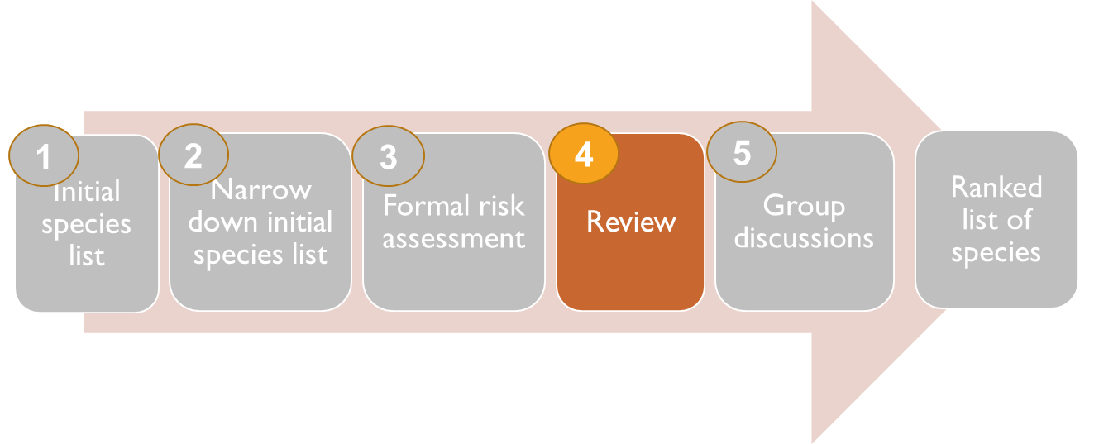
Review process
Review process was done by someone other than the original author
Original Author
Reviewer
+
https://invasions.si.edu/nemesis/browseDB/SpeciesSummary.jsp?TSN=-674
Notes:
During the review process, the summary of answers and scores from the AS-ISK assessment as well as references and links to databases were given to an independent reviewer, who either agreed or disagreed with the original assessment. Where the reviewer disagreed, he had to indicate what specifically he disagreed with and provide evidence to support his stance.
So this is where we are in the phases of the project at the moment. We are still wating for some assessments to come it. And once they do, we will break out into discussion groups based on our expertise, to decide on a final watch list.

Slide 24
Summary
17 Ascidians
61 Bivalves
16 Bryozoans
483 Corals & Anemones
127 Decapods
72 Echinoderms
51 Elasmobranchs
228 Fish
70 Gastropods
= 1,109 species
9 Ascidians
48 Bivalves
8 Bryozoans
19 Corals & Anemones
21 Decapods
3 Echinoderms
0 Elasmobranchs
26 Fish
11 Gastropods
= 145 species
(and counting….)
Notes:
Should be over 150 species once they all come in.
Now although I would love to share preliminary results with you, I don’t think its appropriate since we haven’t broken out into groups yet and discussed the final list.

Slide 25
Thank you!
Katie O’Shaughnessy and others
E: oshaug3@gmail.com
Notes:
Robin Reichers and Dakus Geeslin

Slide 27
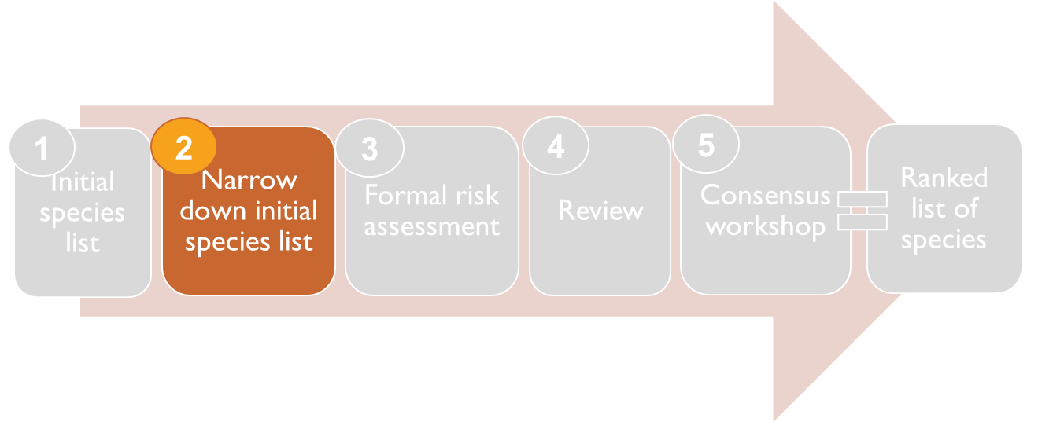
Initial species lists - expectations
Objective:
To determine which species are of potential high risk and, thus, of which should be formally assessed
Narrow down the list based on expertise
Add species to the list that we may have missed
Upload Excel spreadsheet (with your advice for formal risk assessment for each species included) to our shared folder
If unfamiliar with some taxa, please use the Rapid Risk Assessment spreadsheet to help determine level of threat
This assessment is for your own use and does not need to be submitted to the organizing team
Qualitative – gets you familiar with the species quickly; can use distribution info included in the ‘Helpful notes’ section of Initial Species List
Quantitative
Notes:
Finally …

Slide 28
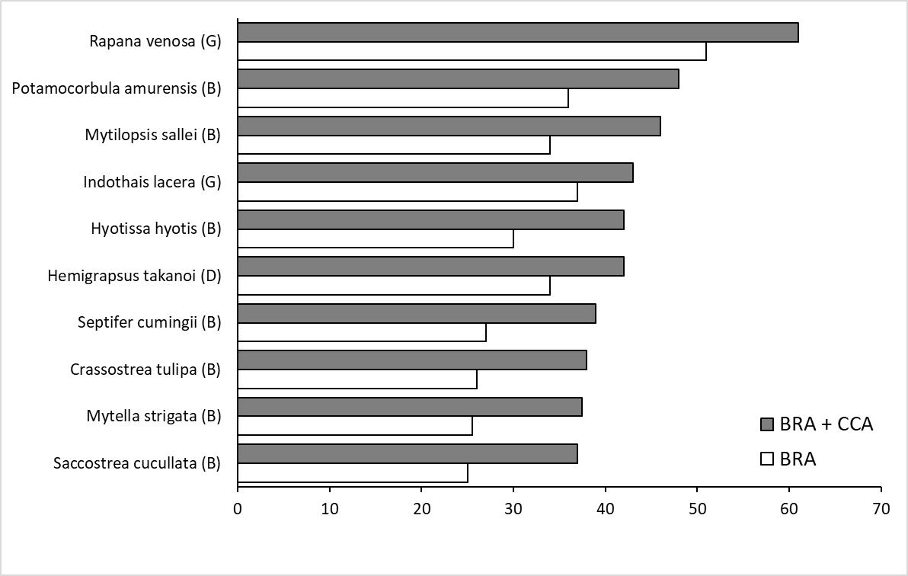
Preliminary results
B = Bivalve
D = Decapod
G = Gastropod
Notes:
These are very early results which have not yet gone through group discussion, but these have gone through review.

